Slide 1
Exploratory Analysis
Snack Shopper Data
And
MLB Attendance
Kevin Shea - April 2015
email: shea.kevin.m@gmail.com

Slide 2
Analysis to Review
Exploratory Analysis of Snack Purchases
K-means clusters
Crosstab Analysis
Marketing Implications
Understanding MLB Attendance
Building a regression model
Data Wrangling with SQL and R
Assessment

Slide 3
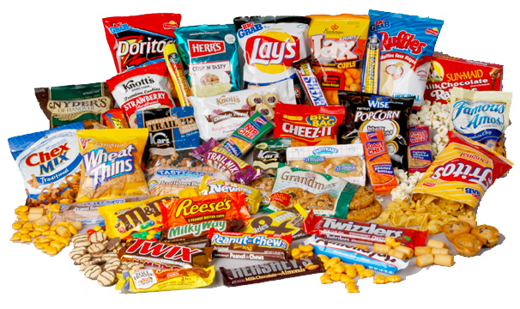
Snack Purchase Analysis

Slide 4
Overview of Study
Random Sample of 26 weeks of transaction data for 650 store shoppers of a particular chain of supermarkets
Cluster analysis divided groups into 6 segments
Analysis of differences between clusters for:
Types of Bag Snacks purchased
Amount spent on each type of Bag Snack
Total amount spent on Bag Snacks
Frequency of Bag Snacks purchase
Amount of time spent at supermarket
Total number of visits to the supermarket
Tools used – R and Excel

Slide 5
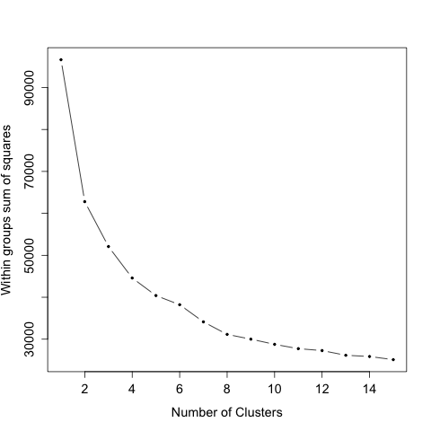
Determine how many clusters
Wrote R script to calculate Sum of Squares and produce chart
Utilized “elbow-test” to choose number of clusters

Slide 6
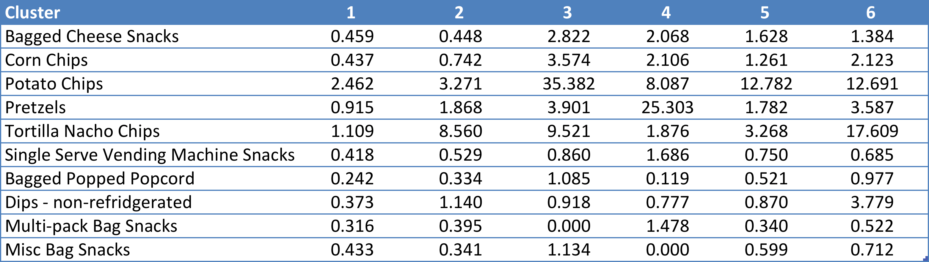
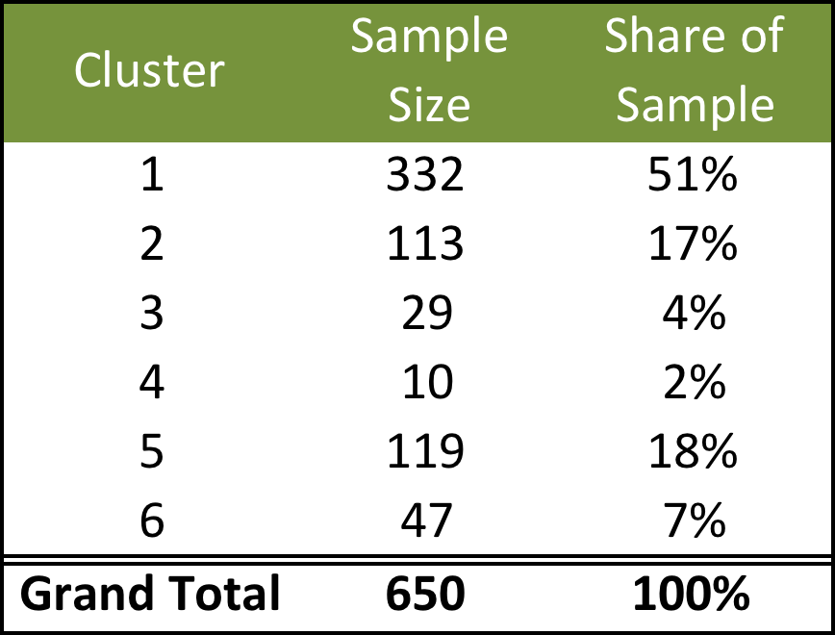
Results of K-means Cluster
Utilized R-function: kmeans(snack_purchase, 6) to find centers of clusters

Slide 7


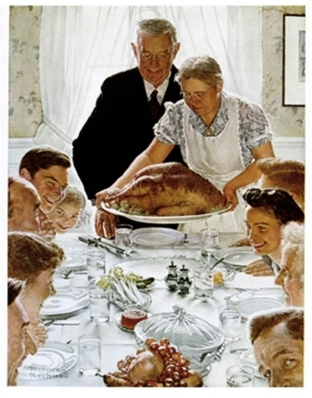


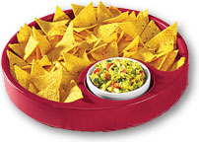
Marketing Segments
Cluster 1 - Infrequent Shoppers | Cluster 2 - Homebodies
Cluster 3 – Middle America | Cluster 4 – Pretzel Kings
Cluster 5 – Cost Conscious | Cluster 6 - Entertainers
Spend little
Don’t skew toward any income
Largest Segment
Variety of snacks
Never the highest for any snack category
Spend more than any other segment
Heavy on Potato chips
41% between $35-74K
Really like pretzels!
Small sample size
Preferences like Middle America but lower spend
56% under $49K
Smallest for $100K+
Varied snack purchases in large quantities
Limited snacks intended for single person

Slide 8
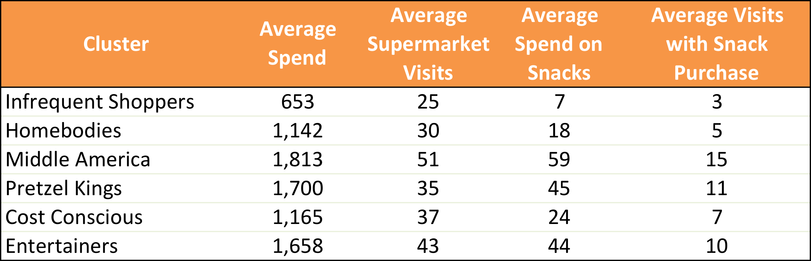
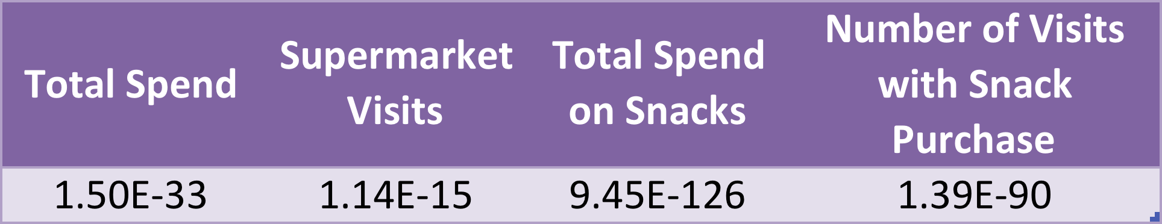
Differences in Spending Habits
Average Spend and Visitation for Each Cluster
(Generated using Excel pivot table)
P-Values for Anova Assessment on Clusters
R command - anova(lm(snacks[,"fit.cluster"]~snacks[,"cnt_snck"]))

Slide 9
CrossTab Analysis of Demographics
Chi-Square Test revealed income was only statistically significant demographic across clusters (p < 0.05)
Will not consider non-Income demographics when making comparisons of clusters
P-Values Resulting from CrossTab Analysis with Chi-Square
R command: CrossTable(snacks$fit.cluster, snacks[, factor], chisq=TRUE)

Slide 10
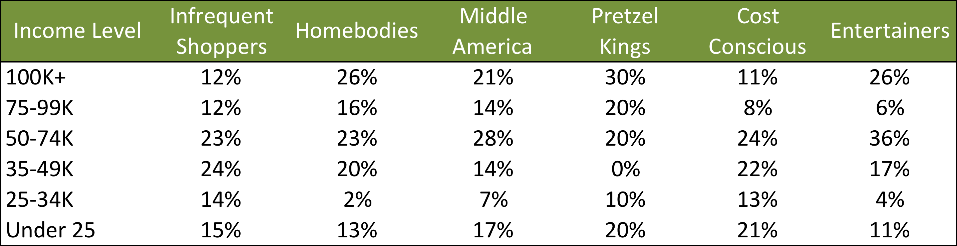
Income Analysis of Clusters
Infrequent shoppers lack of purchases does not appear to be driven by income
Cost Conscious lowest among top-2 income brackets

Slide 11
Marketing Assessment - Entertainers
High purchase amounts across multiple categories
Only group with 2 snacks in double digits
Potential Marketing Responses
Combo coupons for chips and dip
Display nachos near new snack products to help drive sales

Slide 12
Marketing Assessment – Infrequent Shoppers
What We Know
What Might be the Reasons
Spend least among clusters
Visit least among clusters
Lack of spend and visits doesn’t appear to be driven by lack of money
Household size was not statistically significantly different from other clusters
Prefer different supermarket chain
Store proximity
Product selection
Low calorie diets???
What We Need to Understand
Why people choose a supermarket
What motivates their purchase choices
What can bring bring people to our store

Slide 13

Baseball Attendance

Slide 14
Overview of Study
Analysis of game-by-game attendance for MLB teams 2001-2014
Utilized Retrosheets game logs for primary data set of attendance and results for individual games
Loaded game logs into MySQL database to allow for easier study
Utilized Lahman database of MLB statistics for additional variables
Data comprised over 34,000 observations
Created R scripts to perform regressions of multiple factors for all MLB teams as a set as well as individual teams

Slide 15
What impacts MLB Attendance
Variables Analyzed
Variables to be Analyzed Later
Prior Attendance
Prior Season’s Wins
Current Wins
Team Salary
Age of Ballpark
Population of City
Ticket Prices
Day of Week
Day or Night Game
Promotions
Opponent Team Popularity

Slide 16
Getting our data ready to analyze

Slide 17
Constructing Data Table to Analyze
Getting Source Data
Retrosheets Game Logs
Cleaning Data
R script to subset game logs for relevant data to analyze and format to load in database
Storing Data
Create SQL queries to create and load tables for source data
Calculating Key Values
Combing Data for Regressions
Retrosheets Ballpark data
SQL script to calculate Home Game number
Series of SQL scripts to append variables to single table
Metro Area Populations
SQL script to calculate current wins for season
Load information for both into tables
Used multiple scripts for easier debugging
Output contents of table to txt file for use in R

Slide 18
Now that we have our data. Let’s do some regressions!

Slide 19
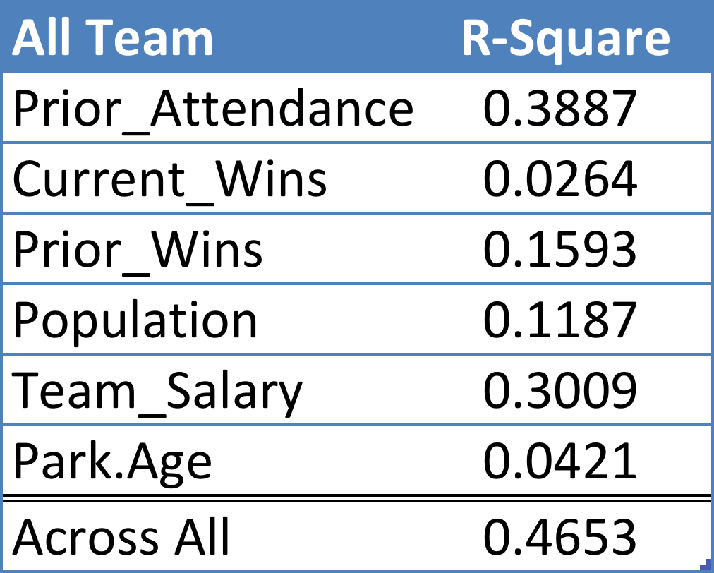
Regression across all MLB teams
Including all factors explains only 46% of the variation in attendance
Prior Attendance appears to hold the most predictive value
Likely significant correlation between variables, as the sum of the individual R-squares are significantly less than the R-square of the model using all variables
Linear Model Formula for All Variables:
0.0001*Team_Salary + 0.4312*Prior_Attendance + 29.41*Current_Wins + 108.21*Prior_Wins + 0.0001*Population + 6.88*Park.Age + 1,340.57

Slide 20
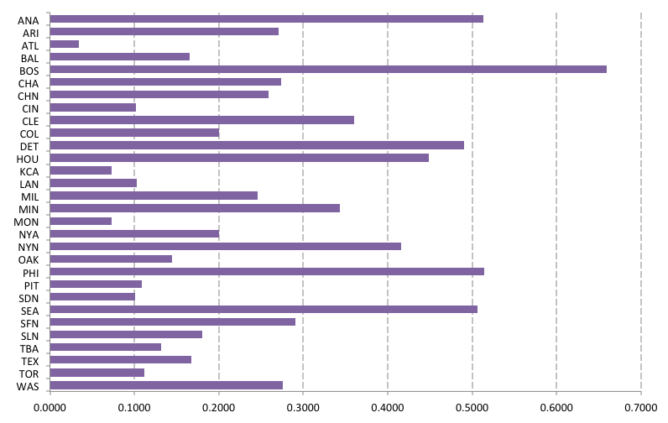
R-Square Values for Each Team
R-square for Prior Attendance + Prior Wins + Current Wins + Team Salary + Park Age
Note: Marlins excluded from individual team data set due to complications with name change from Florida to Miami

Slide 21
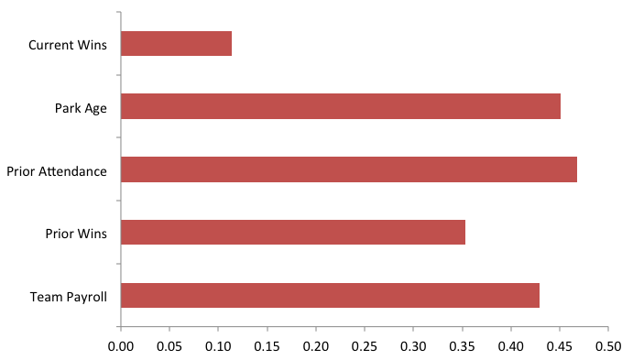





Which team ranks highest for each variable
Max R² Values for Each Variable

Slide 22

Looking at the Cleveland Indians
Compared to other teams the Indians had a high R² for Current Wins, Park Age, and Prior Attendance
These results suggest that Cleveland has a core set of fans that come year after year
Winning should bring in more fans, but don’t expect much to carryover into the next year
Payroll has a limited impact on attendance

Slide 23
How do we assess these regressions
What seems good
What needs to be understood
Explains close to half, which seems reasonable
Prior Attendance having a big impact passes the “smell test”
Provides good starting point for more comprehensive model
How the variables interact
Expected park age to be driver for teams with new stadiums – doesn’t appear to be the case
Impacts of other variable such as price

Slide 24
Further Information
The following links provide access to data files and scripts created to produce the analysis in this presentation.
https://github.com/kevinshea/Snacks
https://github.com/kevinshea/MLB_Attendance

